Slide 1
FRATERNITY AND SORORITY POLITICAL ACTION COMMITTEE FRATERNITY AND SORORITY ACTION FUND
2024

Slide 2
Our Mission
The Fraternity and Sorority Political Action Committee
is a bipartisan organization that
provides financial support to candidates who
defend and enhance the fraternity & sorority experience.

Slide 3
FSPAC SUPPORTS FGRC FOCUS & LEGISLATIVE PRIORITIES
Freedom of Association
Due Process Rights
Campus safety and hazing incidents
Freshman Fall Recruitment
Tax Deductibility of Donations for Housing

Slide 4
A UNIFIED FRONT ON A NATIONAL PLATFORM
900,000 undergraduates
9,500 chapters
Over 700 campuses
9.2M living alumni

Slide 5
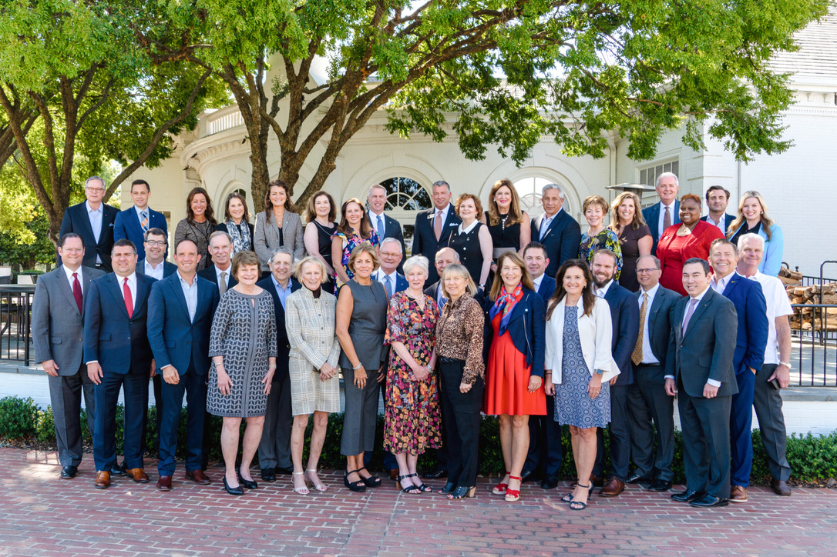
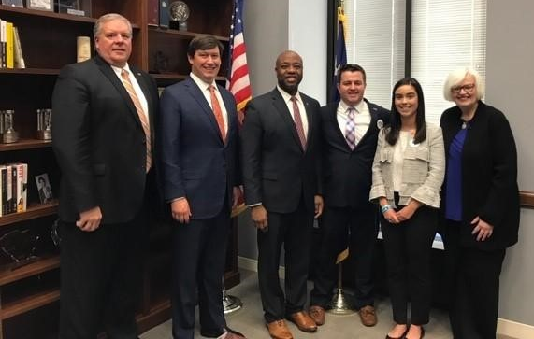
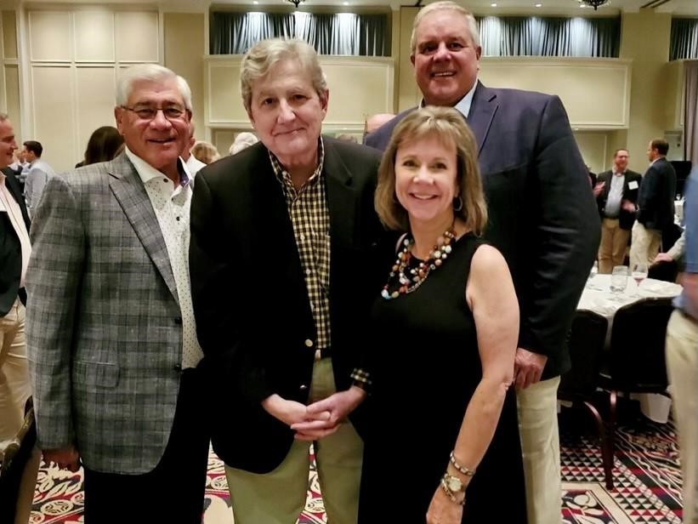
Fraternity and Sorority PAC (FSPAC)
FSPAC Board of Directors
Enables support/election of candidates that support our policy goals which amplifies our voice in Washington policy debates.
Founded in 2005
2022 Elections:
195 candidates supported 91% elected
Largest PAC focused on higher education issues
BIPARTISAN

Slide 6
2024 FSPAC BOARD COMPOSITION
29 women representing 11 NPC groups and1 NPHC group
31 men representing 15 NIC, NPHC, & other groups
3 past NPC Chairmen
4 past NIC Chairmen
Past national NPC and NIC presidents, CEOs, foundation trustees
Current NPC & NIC leaders
Industry leaders

Slide 7
FSPAC Fundraising – Where do the dollars go?
GENERAL FUND
Only source for direct contributions to candidate campaigns
Individual donations only; no organizational donations permitted
Maximum donation limit of $5,000 annually per donor
INDEPENDENT EXPENDITURE ACCOUNT
No direct campaign support; research, polling, administration, etc.
Individual and corporate donations
No maximum donation limit
FEC REQUIRES FSPAC donors who give more than $200 a year be publicly disclosed

Slide 8
FSPAC 2005-2024 Fundraising Performance
Goal: $1 Million
2022-2024 Election Cycle
$6 Million since 2005
6,591 donations

Slide 9
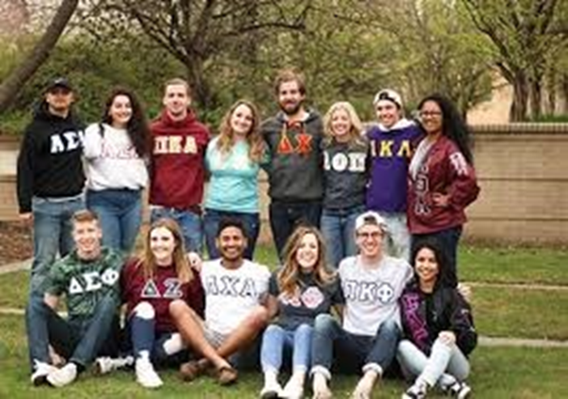
House Passes Freedom of Association in Higher Education Act
The CFAA
PASSED by the House in 2024 with bipartisan support
DEFINES ADVERSE ACTION with a clear definition of what universities CANNOT do to interfere with operations of our systems and chapters
Ensures fair treatment of students
Preserves the Fraternity/Sorority experience
Our work isn’t over!
Work to ensure the Senate follows suit so the legislation becomes law.
Your support can help elect leaders who support us!
WHAT HAPPENSNEXT

Slide 10
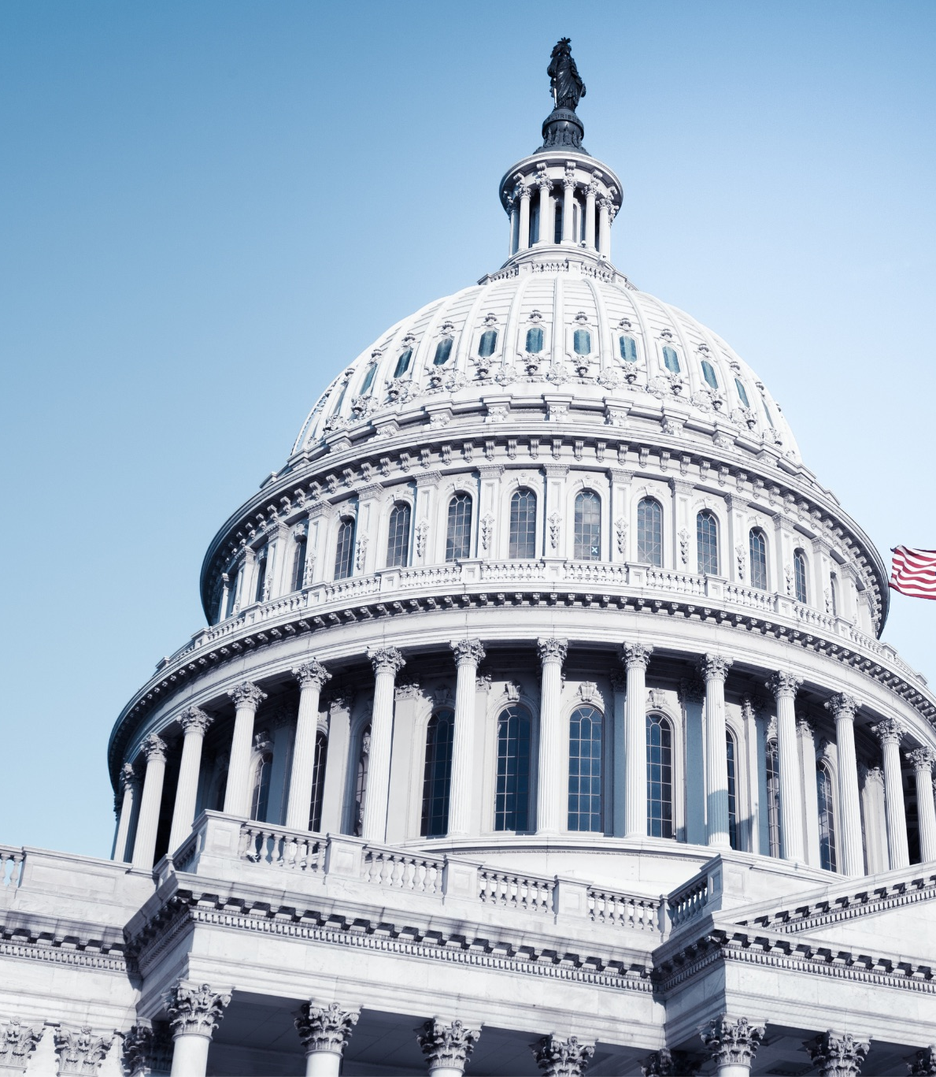
FREEDOM OF ASSOCIATION IN HIGHER EDUATION ACT
The recent passage highlights the consistent and forceful work of the FSPAC and FSAF. House moves to safeguard student’s constitutional rights!
HARVARD - STANFORD
MARYLAND - DUKE - VIRGINIA
And other universities will no longer be allowed to interfere with student’s personal choices for association with the organizations that align with their beliefs and needs.
UNIVERSITY OF SOUTERN CALIFORNIA

Slide 11
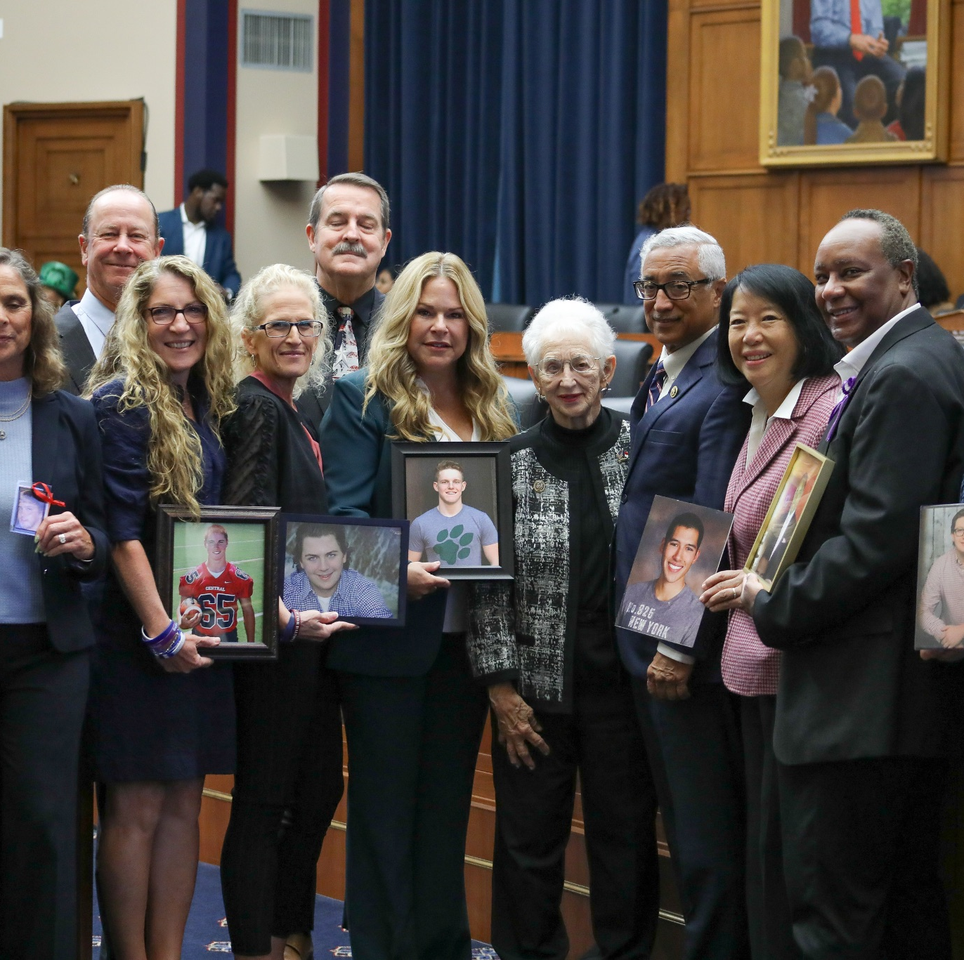
House Passes STOP Campus Hazing Act H.R.5646
STOP Campus Hazing Act passed UNANIMOUSLY in the House of Representatives on September 24
(S.2901/H.R.5646) Promotes increased transparency and accountability regarding hazing incidents
Optimistic the Senate will act after the November election.
At state level, several states have moved forward with Anti-Hazing Coalition model legislation

Slide 12
Fraternity and Sorority Action Fund
Founded in 2015 and is affiliated with the FSPAC
501(c)(4) – may accept unlimited personal and corporate contributions, and donors may be anonymous.
Funds used to support legal work, grassroots engagement, public relations, research, and public polling.
Funds used in legal proceedings at Harvard, Yale, and Maryland, as well as state legislative issues in Louisiana, Tennessee, and Pennsylvania

Slide 13
2024 FSAF PRIORITIES
Develop and execute the 3rd First Amendment Institute to educate students and alumni volunteers on taking coordinated action to defend the single-sex experience at the campus level.
Explore state-level introduction of the Collegiate Freedom of Association Act to protect a student’s right to join single-sex organizations.
Track campus-specific actions tied to due process, recognition and other issues.
Continue grassroots advocacy support for Greek policy issues.
Complete public polling program on issues of interest to the fraternal world and use the data to improve policy engagement going forward.

Slide 14
FSAF Drives Many Fraternal Successes
Harvard – Federal litigation WIN demonstrating schools may not punish students for joining single-sex organizations.
Yale – Federal litigation WIN at trial and appellate court affirming fraternities may control their single-sex membership decisions and fraternal housing is not a place of public accommodation.
State Hazing Laws – Working across multiple states to strengthen criminal penalties and enhance transparency around hazing activities.
Local Zoning – Creating the long-term legal trail to allow fraternities/sororities to go unrecognized without losing their housing due to zoning regulations tied to official recognition.
Grassroots Advocacy – Funding tools for NPC and NIC to engage in multi-level advocacy and issue education with its members.

Slide 15
TOGETHER, WE CAN ACHIEVE MORE
We need you!
Ideally – all 26 women’s organizations at the FSPAC table
To effectively challenge – we must be proactive:
Women’s voices matter and make a difference
We will continue to play a critical role:
New and ongoing relationships with elected officials
Consistent advocacy = the wins achieved
Our ask of you:
Consider joining the FSPAC board
Each board member raises $6500 per year to maintain their seat
Donate to FSPAC as an individual or to the IEA OR Action Fund as an organization

Slide 16
Your Questions?
Please reach out to any of us with future questions or to schedule a time for one of us to join your board meeting for a personalized presentation or conversation with your group!
Carole Jones, FSPAC Political Affairs:
cjjaoii@bellsouth.net 256.603.8093
Donna Chereck, FSPAC Membership: donnaschereck@gmail.com 214.215.4017
Laura Doerre, FSPAC Secretary unc.theta.alum@gmail.com 281.687.6627
Julie Burkhard, FSAF Fundraising Director
Julie.burkhard@gmail.com 813.789.8416
Notes:
”

Slide 17
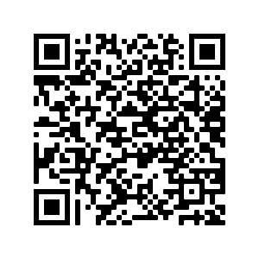
Your donation will defend and enhance the fraternity and sorority experience
https://fspac.org
Paid for by the Fraternity and Sorority Political Action Committee and not authorized by any candidate or candidate's committee. https://fspac.org
Contributions to the Fraternity and Sorority PAC are not tax-deductible for federal income tax purposes. Federal law requires the Fraternity and Sorority PAC to use its best efforts to collect and report the name, mailing address, occupation, and employer for individuals whose contributions are $200 or more in a calendar year. Funds received in response to this solicitation will be subject to federal contribution limits and source prohibitions. Contributions are limited by law to $5,000 per year from any individual or PAC, and contributions from corporations, labor unions, federal contractors, and foreign nationals are prohibited.
Contributions to the Fraternity and Sorority Action Fund are not tax deductible for federal income tax purposes. Contributions are not limited to a specific dollar amount per year and the FSAF is not required to publish donor identification. Contributions may be made by individuals, organizations or organizations and may not be used to support an individual’s election to public office.
Notes:
”

